Slide 1
pedestrian safety
Patrick McDevitt
Preeti Swaminathan
Joshua Herrera
02-Nov-2018
1
Notes:
1

Slide 2
Agenda
Problem statement
Solution method overview
Current situation
Data description
Model(s) construction
Results
Next Steps
2

Slide 3
Opportunity
Description of pedestrian safety as a concept
what is it
why it is interesting to pursue this project
what was motivation to involve with this
3

Slide 4
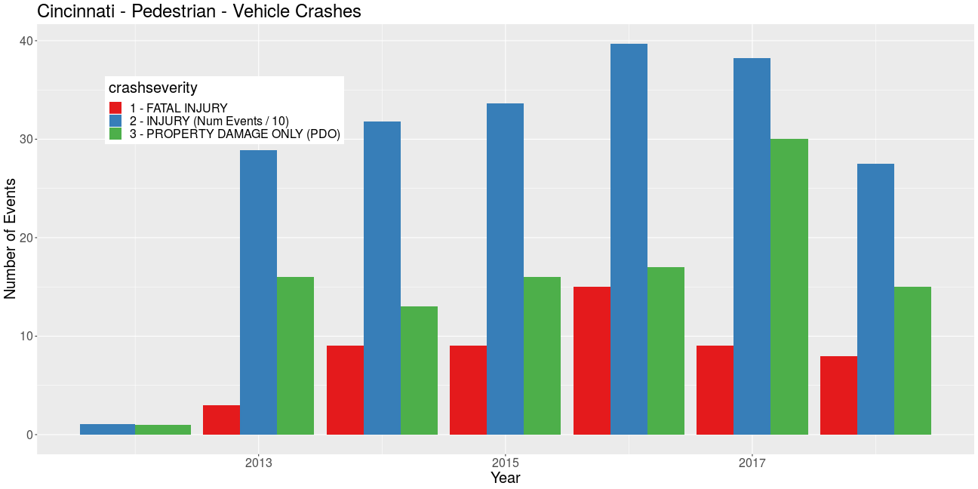
Cincinnati – pedestrian safety experience
add some comparative data vs. national averages
Fatalities : ~12 / year
Accidents w/ injuries : 350 / year
Total pedestrian involved accidents : 700 / year
4

Slide 5
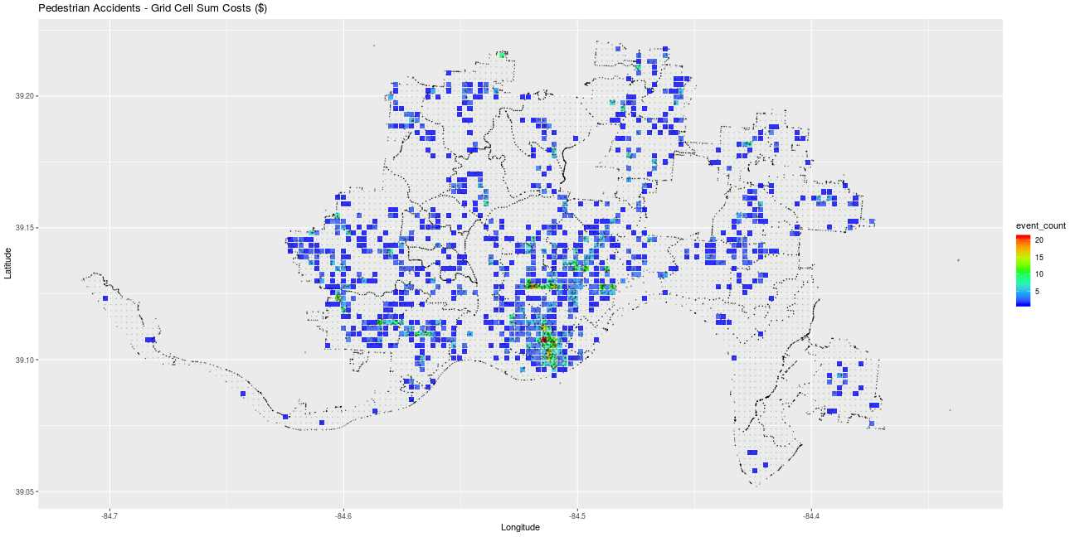
pedestrian accidents – locations / severity
Characteristics
widely dispersed across the city
heaviest concentration at city center & near east neighborhoods
National Safety Council estimated cost : $$$$$$

Slide 6
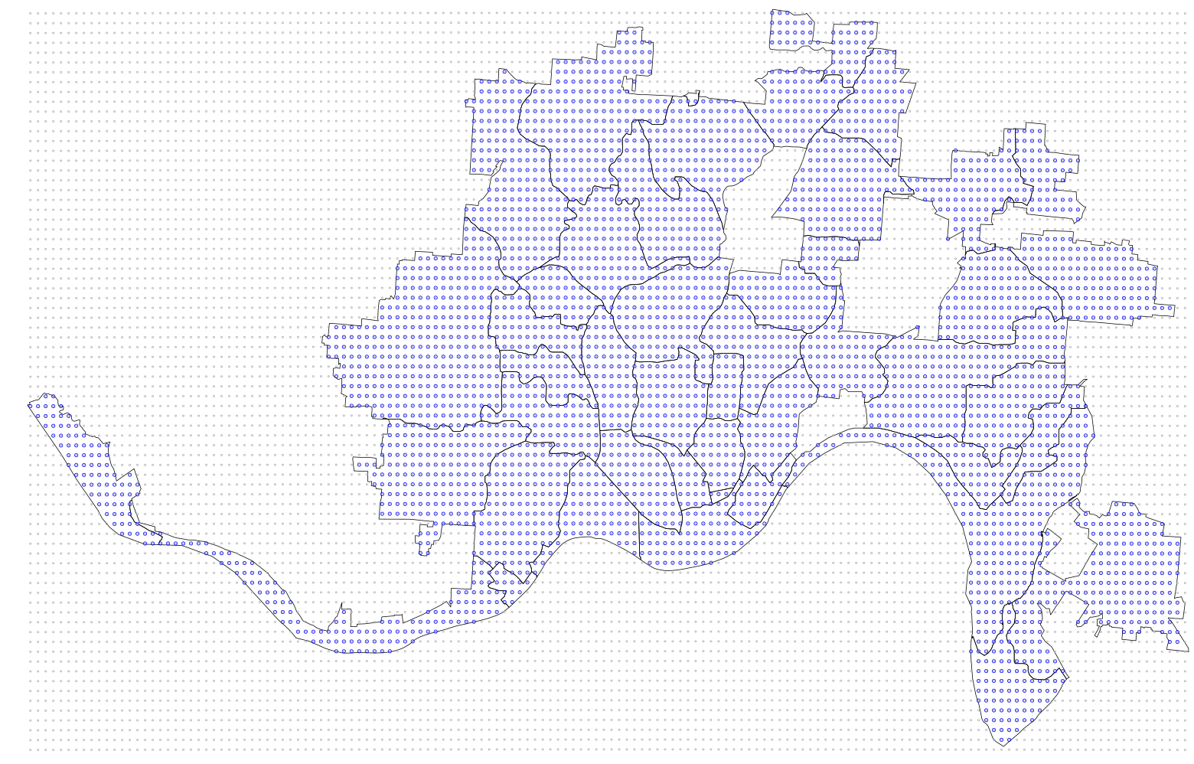
analysis method concept
Grid cell approach
accumulate experience of candidate features in each cell
grid cell size : 250m x 250m
uniform distribution, equidistant edges on earth surface
goldilocks grid size
4196 grid cells
(~80 sq-miles)
6

Slide 7
Model concept
Independent estimators
Non-pedestrian accidents
(cost, number)
Pedestrian survey responses
(category, number)
Reported near-misses
(location, number)
Street surface areas
(width, length, area)
Walk Scores
Fire incidents
(type, number)
Non-emergency service requests
(type, number)
Property values
(median sale values)
Pedestrian accidents
Cost factor = Sum(accidenti * severity)
(Response)
Pull the data from one representative cell and show all the elements that are contributing as candidate features in that cell
250m
250m

Slide 8
View of some data sets
8

Slide 9
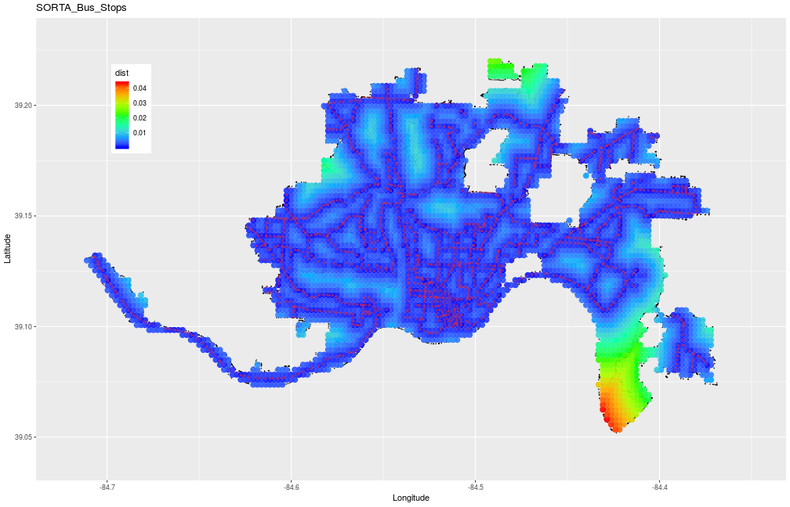
Bus stop localizations
Public transportation network : SORTA bus system
Distance to nearest bus stop in each grid cell

Slide 10
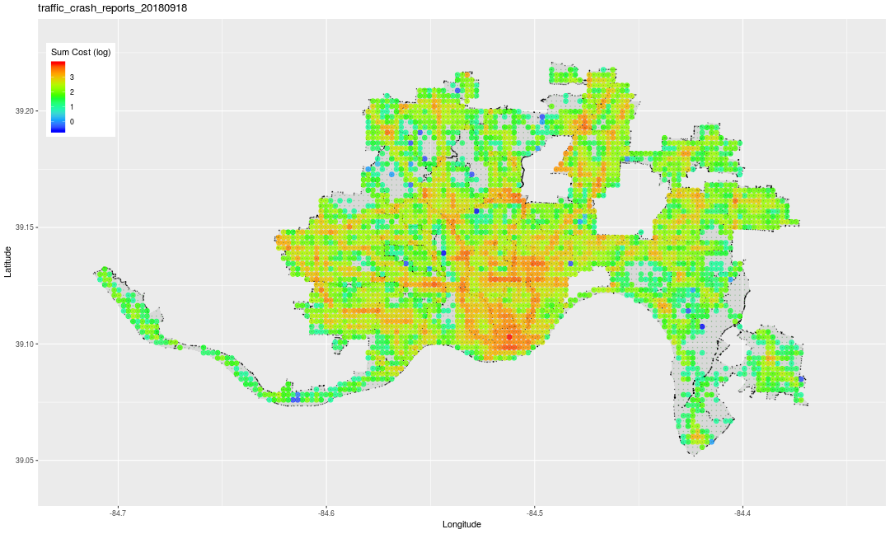
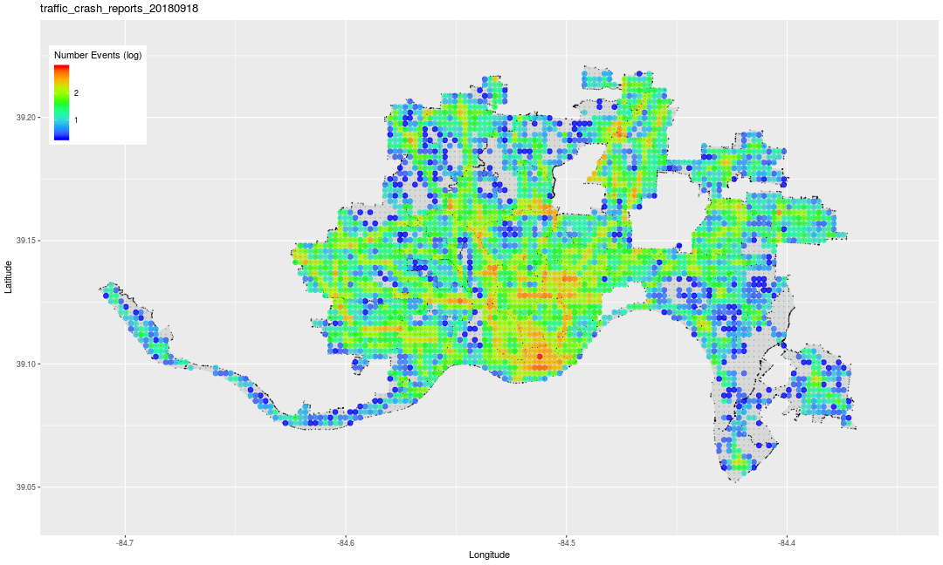
Traffic accidents – non-pedestrian
Costs (NSC model)
Accident density in grid cells
could add a bar chart to show some numeric information

Slide 11
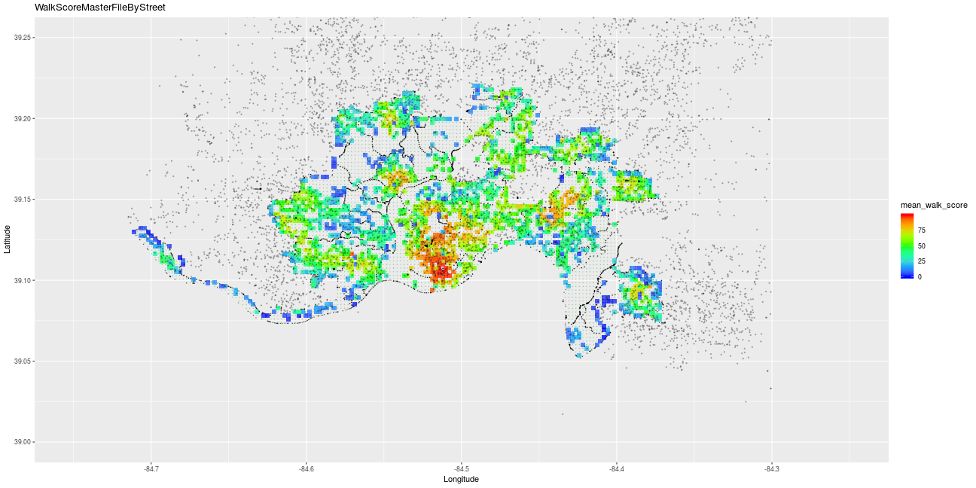
Walk Score®
high score (red)
low scores (blue)
Walk-ability
Add details about what contributes to higher / lower walk score

Slide 12
Feature Development
supplied features
derived features
12

Slide 13
Feature Development (3) – Events
13

Slide 14
Regression analysis
Josh .. add some model perspective / results
14

Slide 15
Regression analysis
15

Slide 16
Supervised learning – decision tree
16

Slide 17
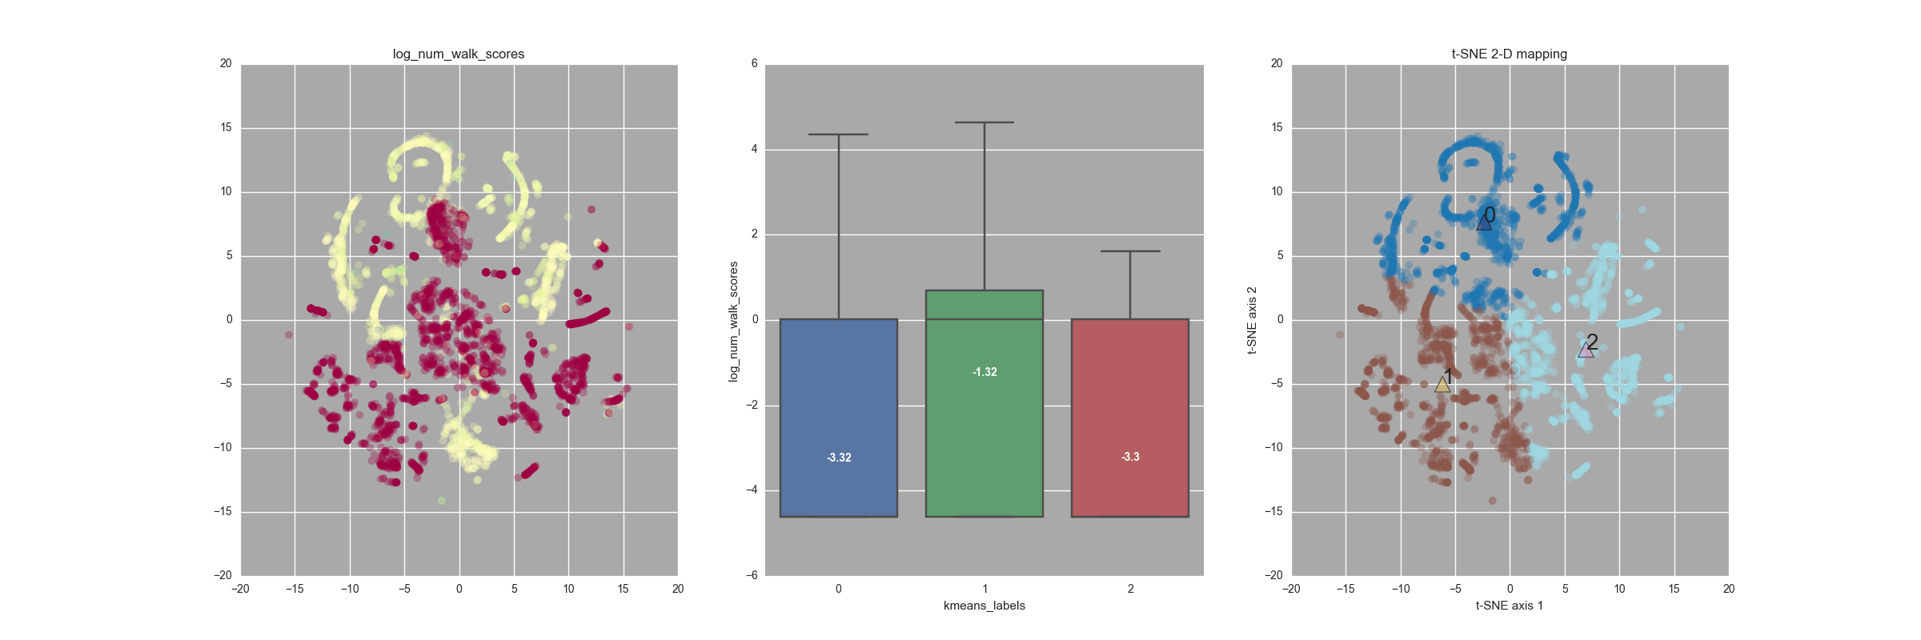
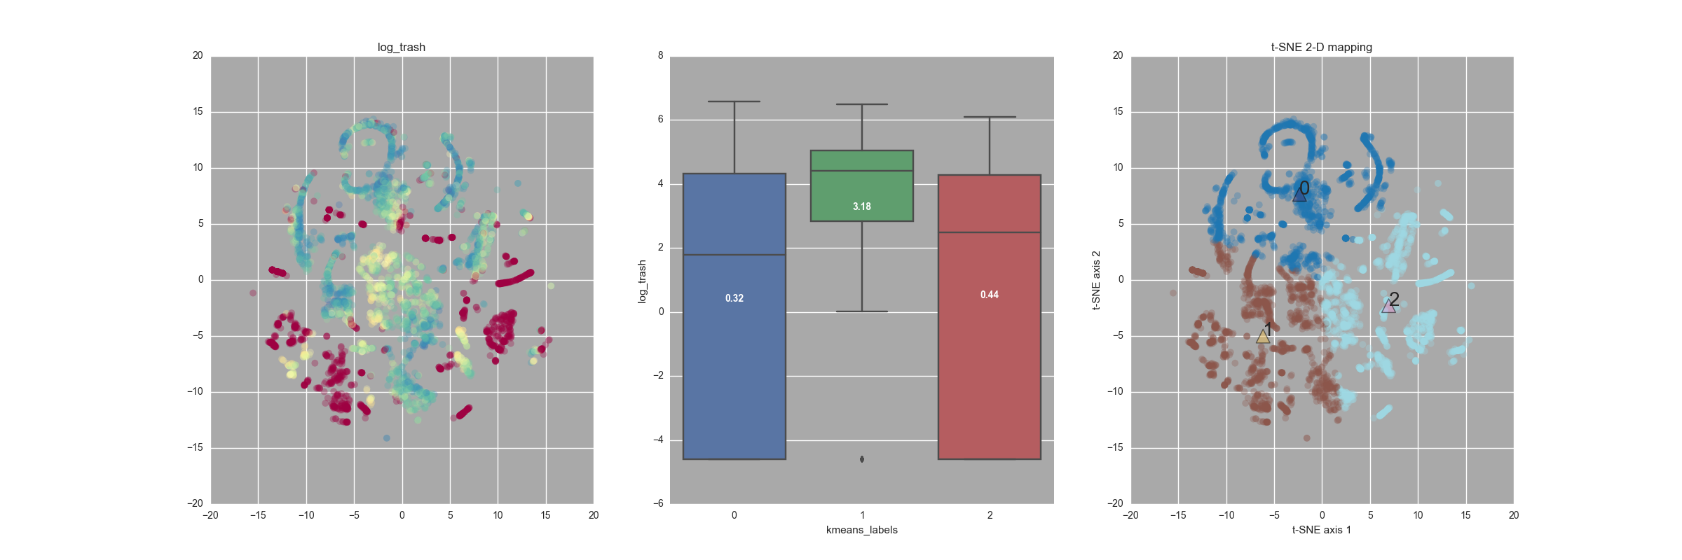
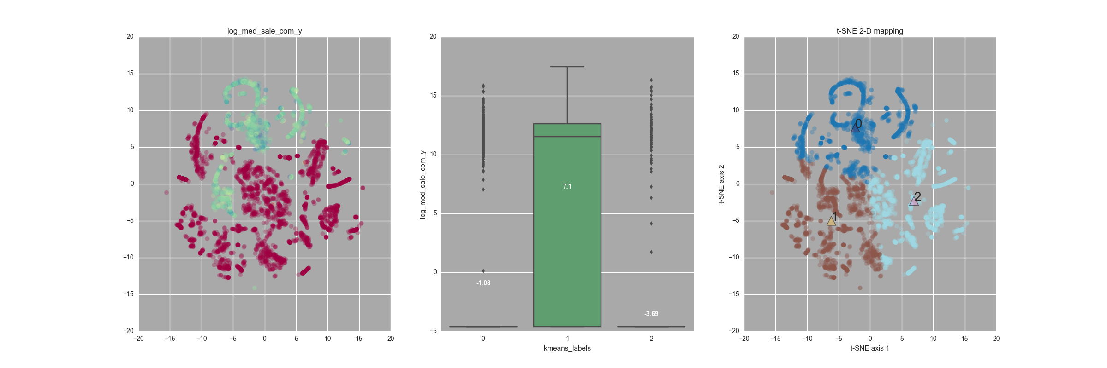
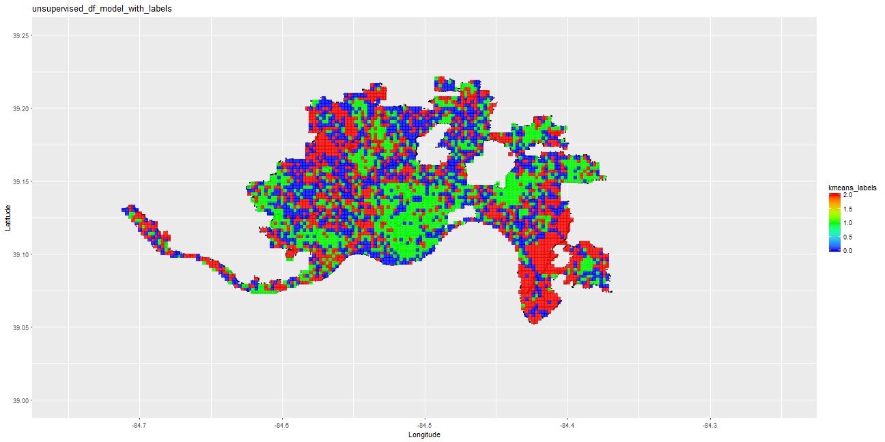
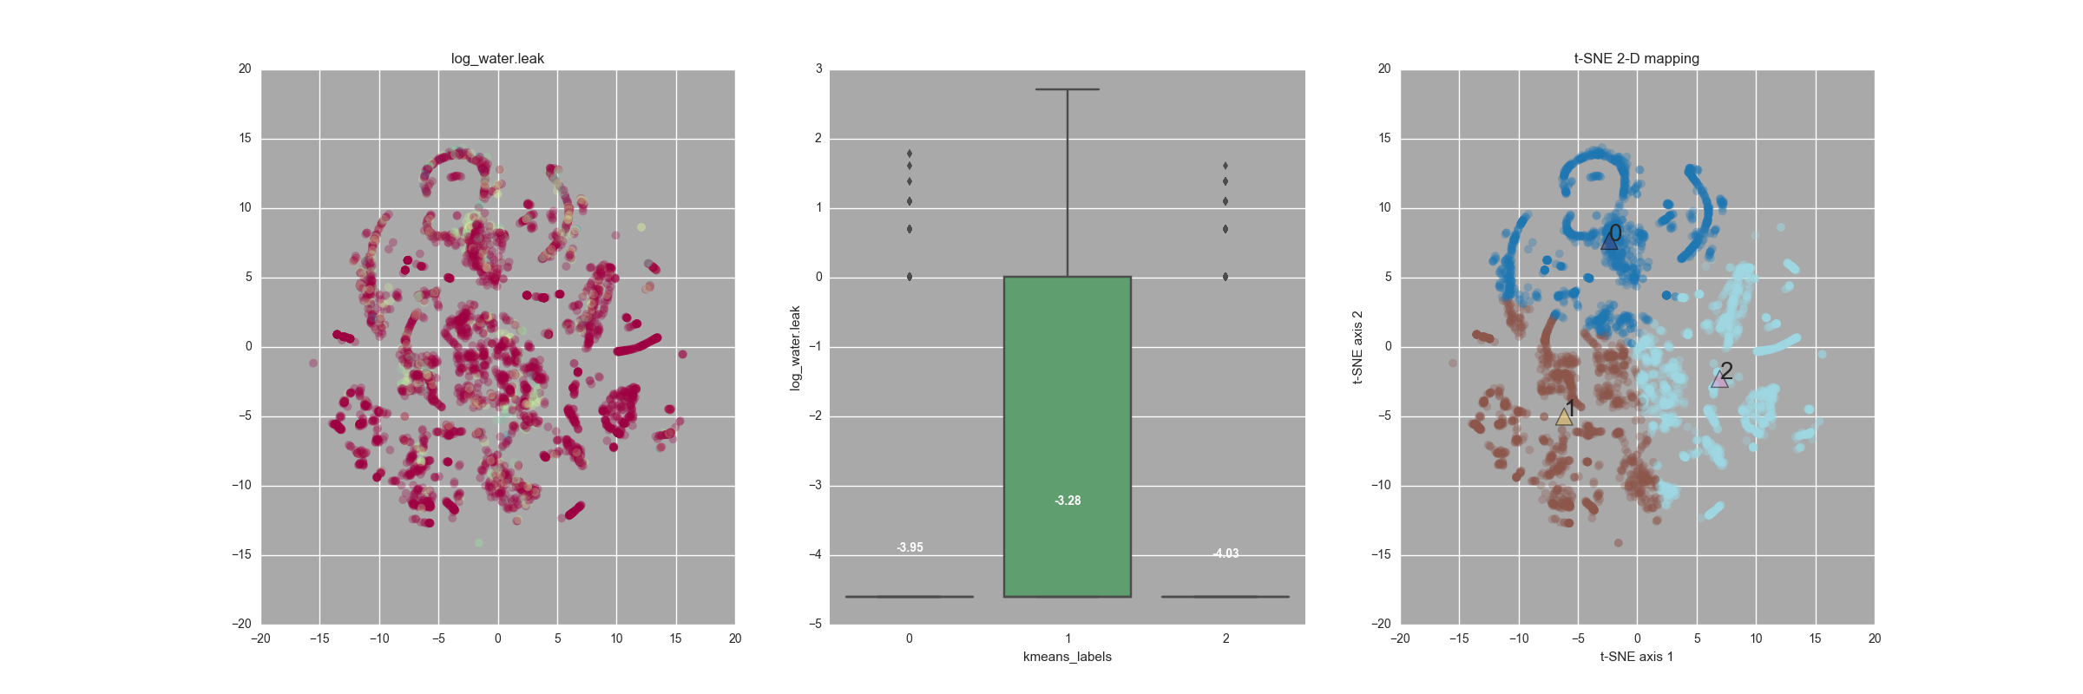
Non-supervised learning – clustering using Kmeans
17

Slide 18
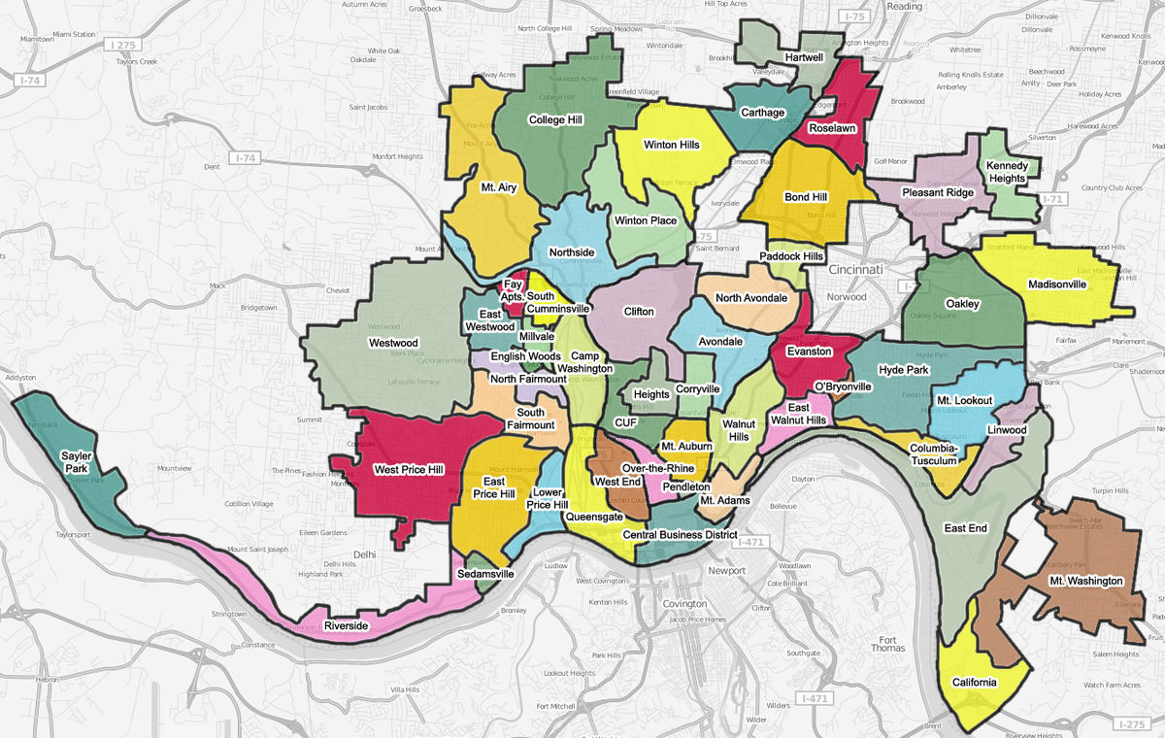
Non-supervised learning - Observations
Cluster 1 dominates the commercial property transfers, Cluster 0 has more residence
Cluster 1 has better overall walkscore, with mean score of 54. Which falls under "Somewhat walkable, Some errands can be accomplished by walk" of the walk score description.
Over-The-Rhine, Mt. Auburn and Central Business District are three neighborhoods with good score qualifying for "Very walkable" conditions.
Pedestrian-Signal issues like vehicles running stop sign, walk signal short, vehicles that do not yield at crosswalks and lack of visibility is mainly around Oakely, Clifton, Hyde park, Madisonville, Pleasant ridge which is mix of cluster 0 and 1
Non-emergency related water leak is predominantely in cluster 1. Top by neighborhoods with high number of water leak complaints are all in cluster 1:
Hyde Park
CUF
Westwood
West Price HIll
East Price Hill
Clifton
Non-emerygency service request for metal thrash is predominantly in cluster 2, while insects and animal related service request is usually from cluster 0
18

Slide 19
Non-supervised learning
Cluster 0: Blue
Property Type: Residential
Top issues:
Animals and insects
Trees and plants
Vehicles run red light/Stop signal
Cluster 1: Green
Property Type: Commercial
Top issues:
Speeding
Traffic
Vehicles do not yield
Water leak
Cluster2 : Red
Property Type:
Industrial
Top 3 issues:
Metal Trash
Parking
Side walk
19

Slide 20
Non-supervised learning
Suggestions:
Walkability can be improved in cluster 1, where mean score is less than 50
20

Slide 21
Summary
Features
developed range of features based on ...
Supervised learning
Some predictive capability – not excellent, but a good starting point
Consider additional supplementary data sources
Non-supervised learning
Initial patterns emerging to support understanding
re-visit after additional features incorporated in data set
21

Slide 22
Summary
22

Slide 23
Thank you &
safe commuting
23

Slide 24
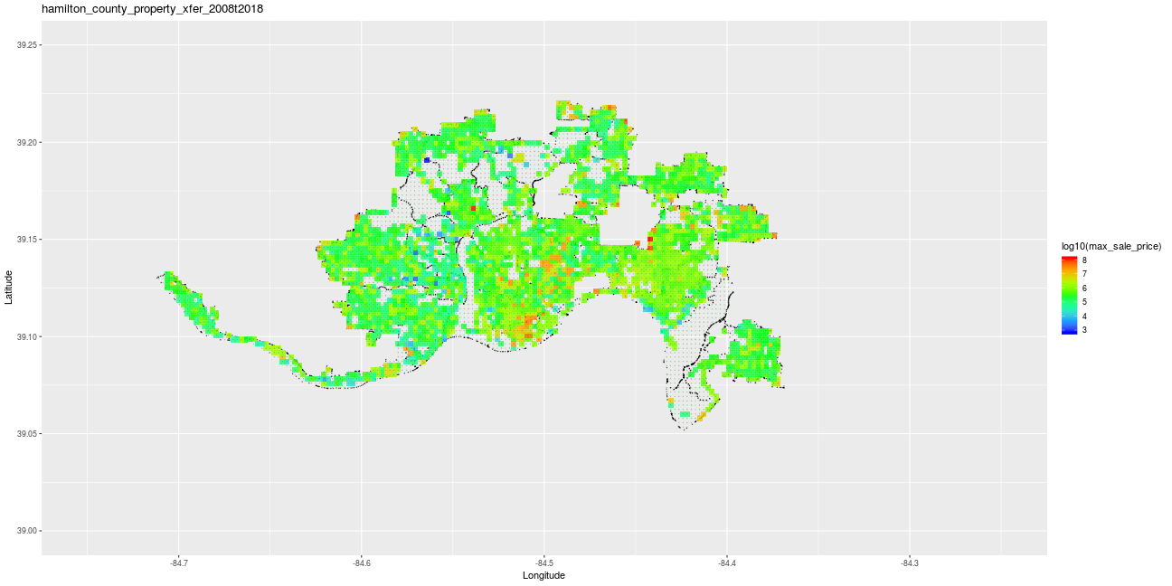

Slide 25
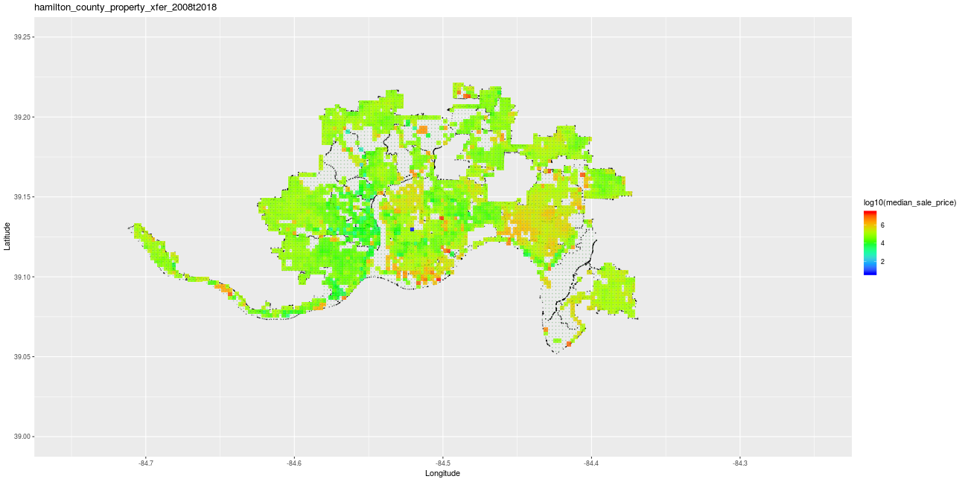

Slide 26
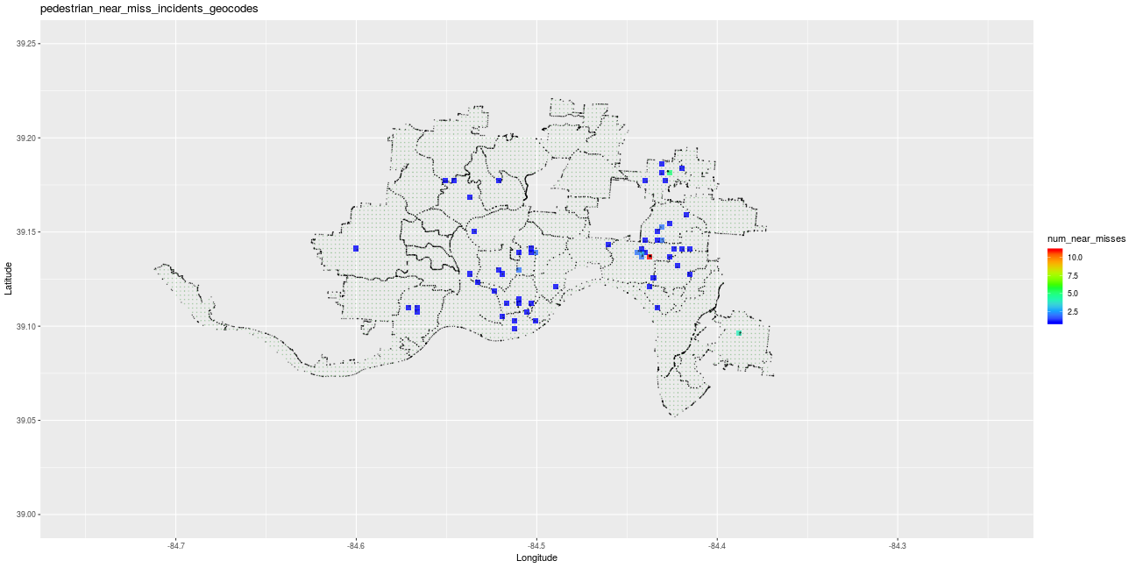

Slide 27
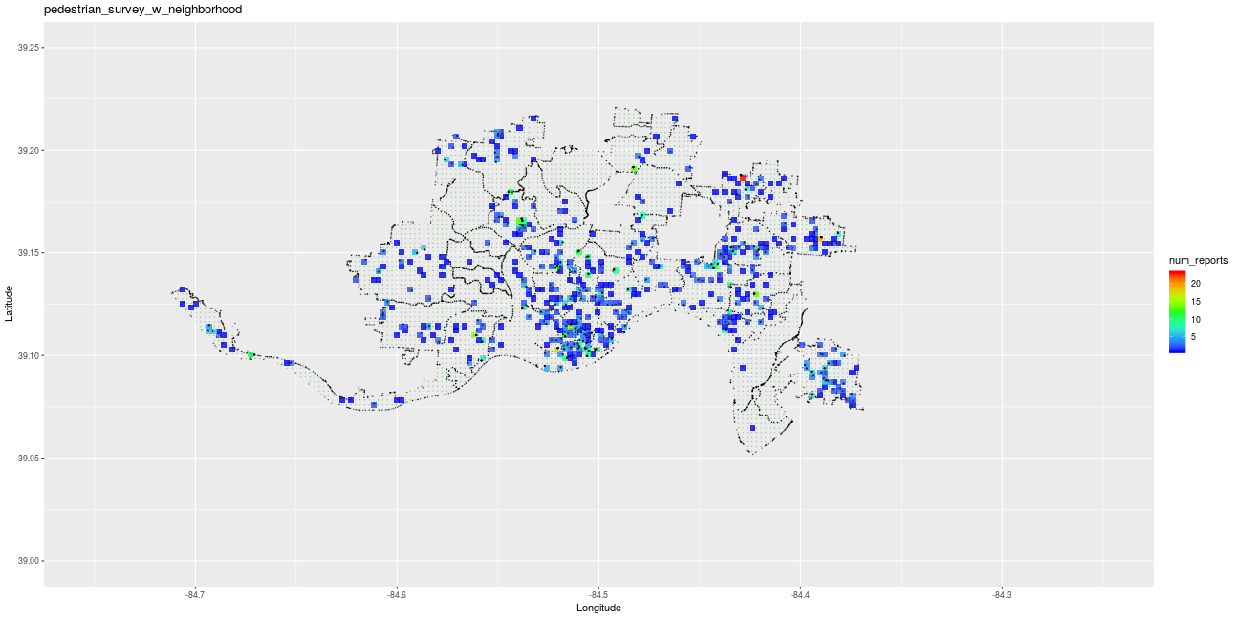

Slide 28


Slide 29
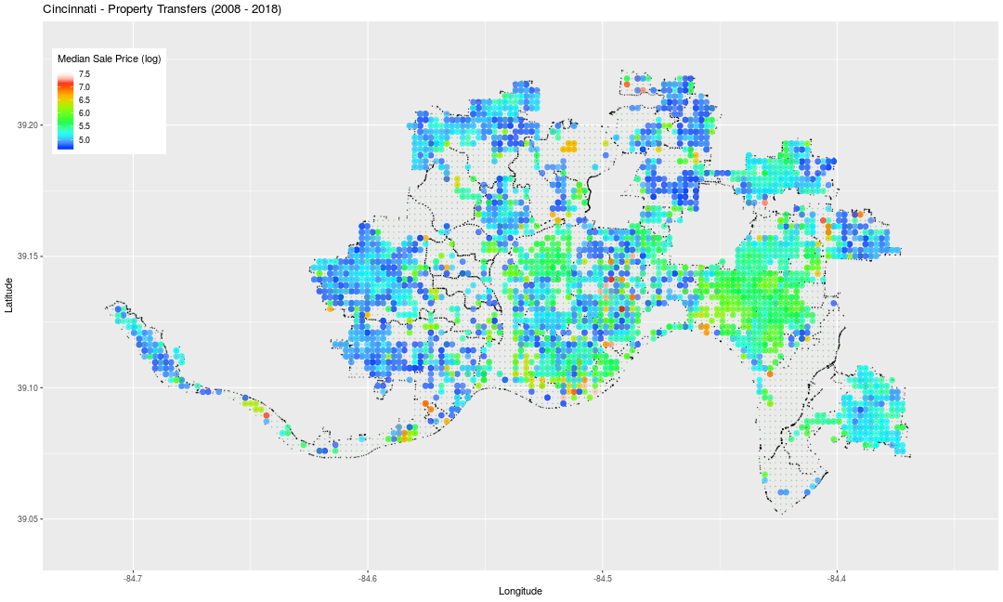

Slide 30
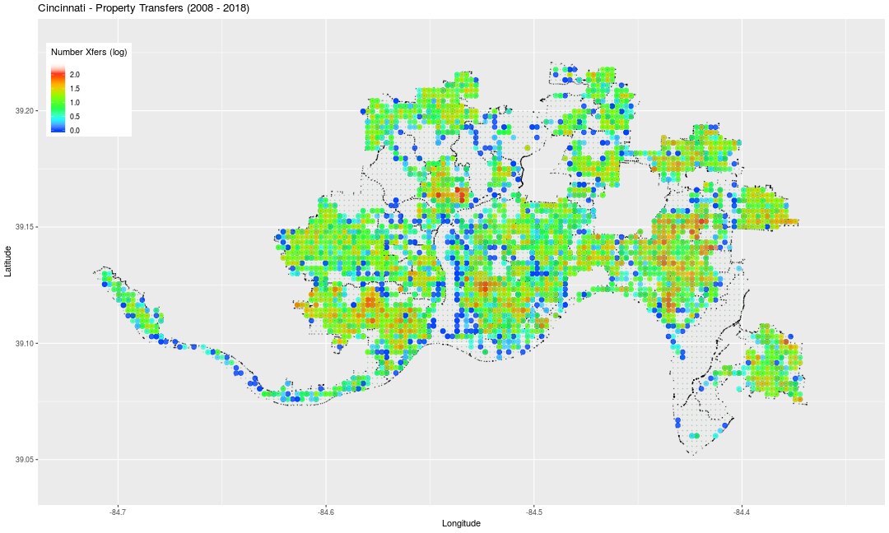
property xfers - qty

Slide 31
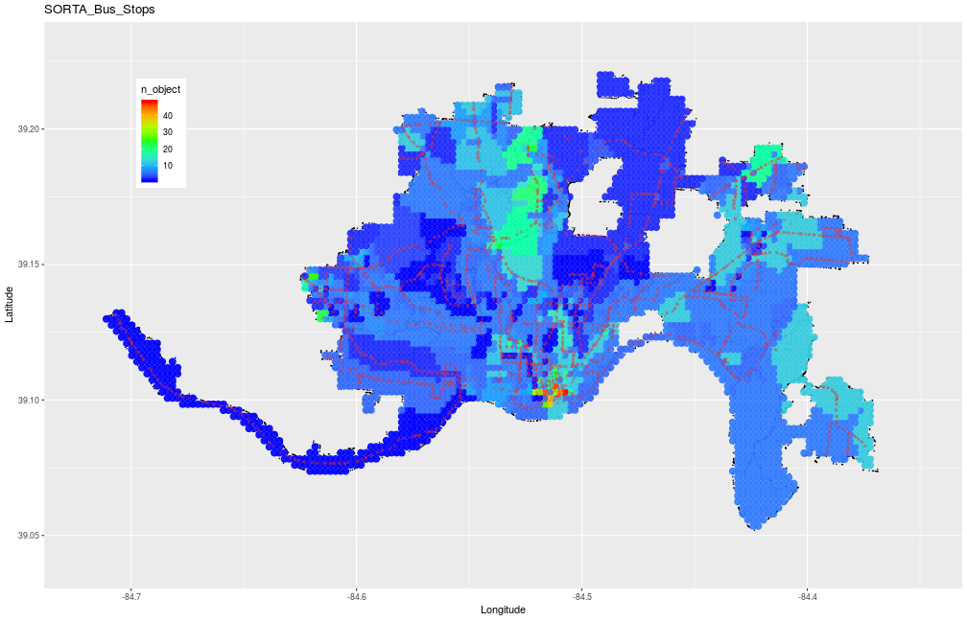
Bus stops

Slide 32
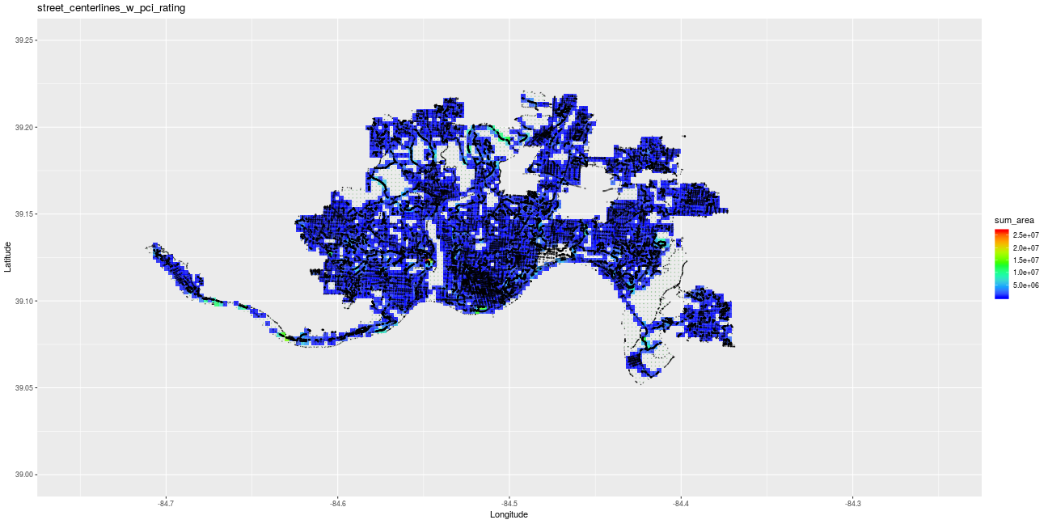

Slide 33
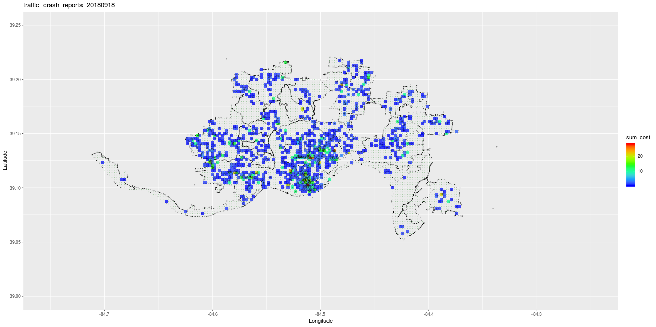

Slide 34
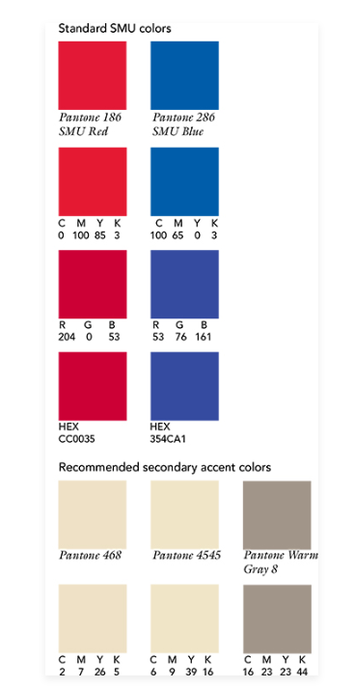
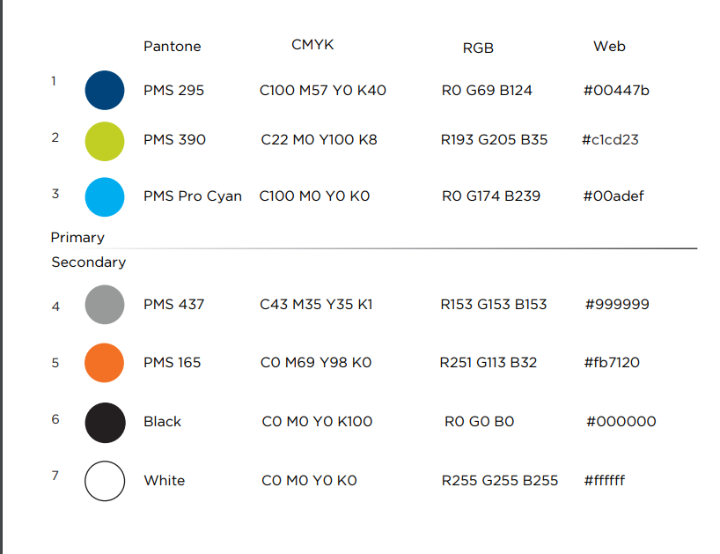
34

